Slide 1

Effective Tag Set Selection in Chinese Word Segmentation via Conditional Random Field Modeling
Hai Zhao, Chang-Ning Huang, Mu Li, and Bao-Liang Lu

Slide 2
介绍
英文文集
Whitespace
中文文集
Chinese text is written without natural delimiters, so word segmentation is an essential first step in Chinese language processing.

Slide 3
常用方法 - 词表分词
词典中找到某个字符串，常用方法：
1）正向最大匹配法（由左到右的方向）；
2）逆向最大匹配法（由右到左的方向）；
3）最少切分（使每一句中切出的词数最小）。

Slide 4
词表分词的缺点
词表中没有的词难识别 如:
1)新词 打酱油 猪流感
2)专有名词，如人名、地名、机构名等
分词歧义 如:
乒乓球拍/卖/完了
乒乓球/拍卖/完了

Slide 5
“由字构词”方法的来龙去脉
把分词视为字的词位分类问题
◆字的构词位置（词位）：
词首B（占领）词尾E（抢占）
词中M（独占鳌头）单字词S（已占全国）
◆分词结果：/上海/计划/到/本/世纪/末/实现/人均/国内/生产/总值/五千美元/。/
◆词位标注：上/B海/E计/B划/E到/S本/S世/B纪/E末/S实/B现/E人/B均/E国/B内/E生/B产/E总/B值/E五/B千/M美/M元/E。/S

Slide 6
Conditional Random Field
Maximum entropy tagger was used in early character-based tagging for Chinese word segmentation [2], [3], while we choose linear-chain CRF as our learning model in this study. It can combine rich feature representation and probabilistic finite state model, too. In addition, it can avoid so-called ‘label-bias’ problem in some degree. Actually, such model was also proved to be very effective in many existing works [8].

Slide 7
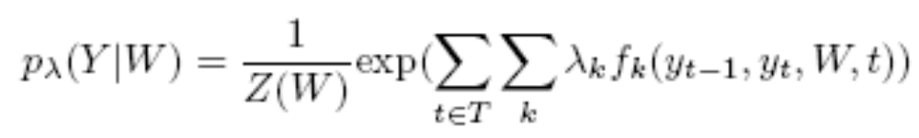
The probability assigned to a label sequence for a particular sequence of characters by a CRF is given by the equation below:
where Y = {yi} is the label sequence for the sentence, W is the sequence of unsegmented characters, Z(W) is a normalization term, fk is a feature function, and t indexes into characters in the label sequence.

Slide 8
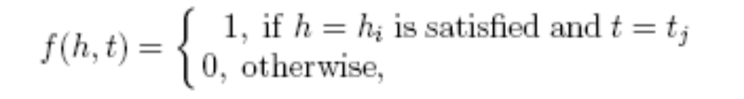
Tag Sets and Feature Templates
The probability model and corresponding feature function is defined over the set H ×T , where H is the set of possible contexts (or any predefined condition) and T is the set of possible tags. Generally, a feature function can be defined as follows,
where hi ∈ H and ti ∈ T .
For convenience, features are generally organized by some groups, which used to be called feature templates. For example, a bigram template C1 stands for the next character occurring in the corpus after each character .

Slide 9
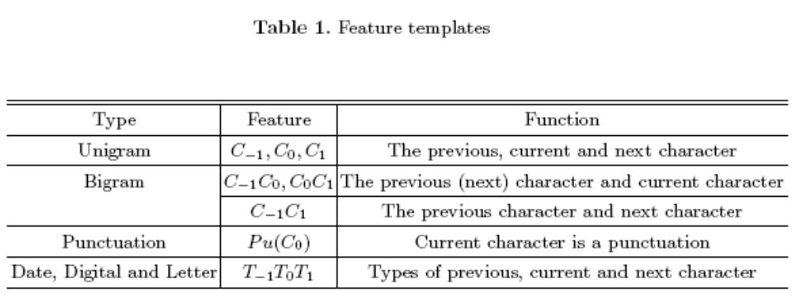

Slide 10
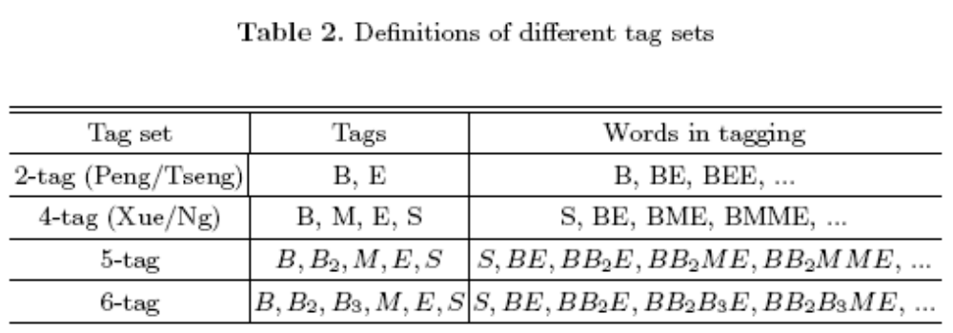

Slide 11
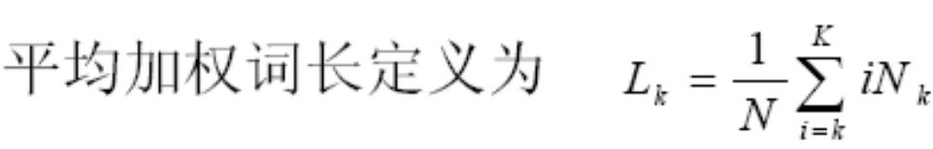
Determine Effective Tag Sets
Notice 6-tag set can label a five-character word without repeating its tags, that is, ’BB2B3ME’, we may take average weighted word length of those words whose character lengths are larger than four as our experimental criteria to determine if 6-tag set should be taken or not.

Slide 12
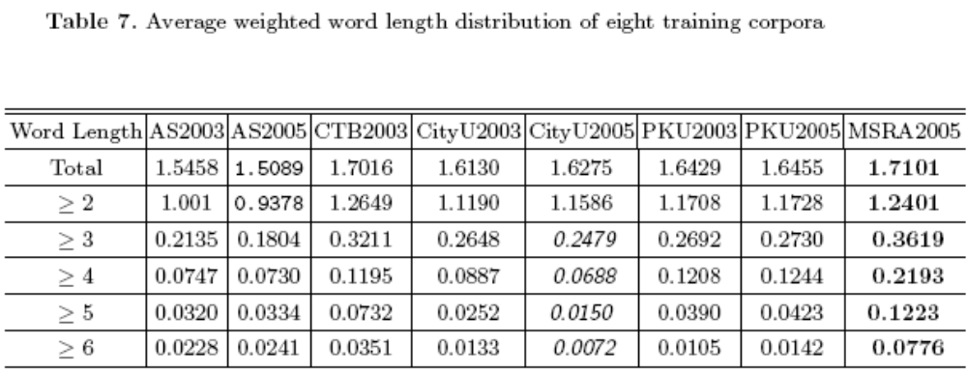
Threshold=0.02

Slide 13
例子
3字符窗口 + 4Tag(词首B 词中M 词尾E 单字词S) +7Template
现在对"人们常"中的人(类别为E)进行标注
7Template 对应的特征分别是
1_人 2_们 3_常 4_人们 5_们常 6_人常 7_B

Slide 14
例子
(1_人, E) 描述的是，一个三字窗口，起始字符为“人”时，中间的字符被标记为“E”的情况
(4_人们,E) 描述的是，三字窗口的前两个是“人”和“们”时，中间字符被标记为“E”的情况
(6_人/常, E) 描述的是，三字窗口的左右分别是“人”和“常”时，中间字符被标记为“E”的情况
(7_B,E) 三字窗口的起始字符被标记为B时，中间字符被标记为E的情况(这个应该就是 1阶状态转移特征)

Slide 15
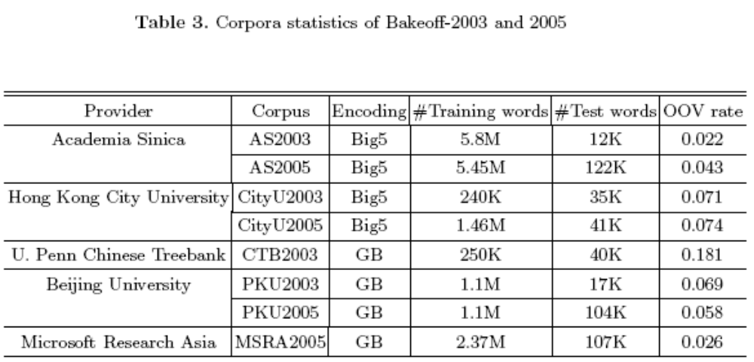
Experiments

Slide 16
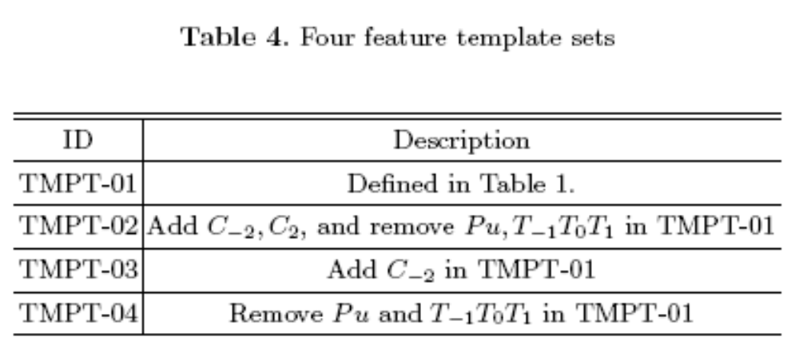
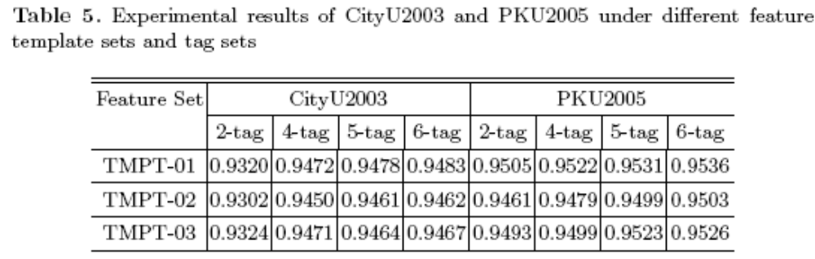

Slide 17
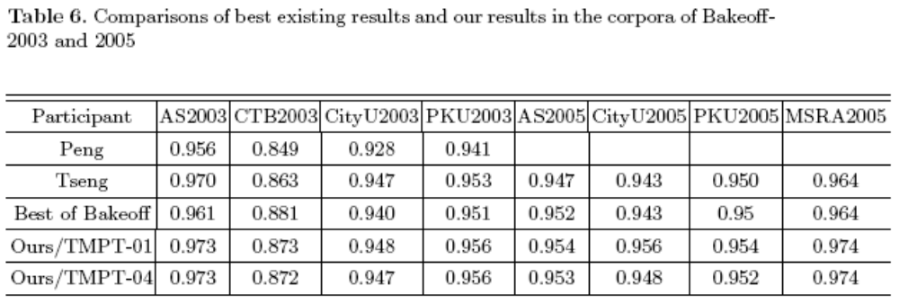

Slide 18
Conclusion
In this work, we have shown an appropriate tag set can give a substantial performance improvement of Chinese word segmentation for character based tagging method under CRF framework.
Furthermore, we propose that average weighted word length distribution of the corpus can be taken as the criteria to choose tag set. Based on the proposed method, our system obtains state-of-the-art performance in all corpora of Bakeoff-2003 and 2005.

Slide 19
Thanks~

